Slide 1


Discordant Chronic Comorbidities:
Problems, Solutions, and Wireframes
Sergio Ramirez Martin
Transylvania University
Lexington, KY
sergiormrz560@gmail.com
Twitter: @sramirezmartin

Slide 2
Methods
Photo elicitation interviews
Affinity diagrams and open coding
Cognitive walkthrough

Slide 3
Problems
Communication between providers
Polypharmacy
Coping with vulnerabilities
Prioritizing illnesses
Financial concerns

Slide 4
Solutions
Centralized Communication with Providers
Medication Management
Access to Reliable Information
Support Networks
Adapting to Changed Lifestyle

Slide 5
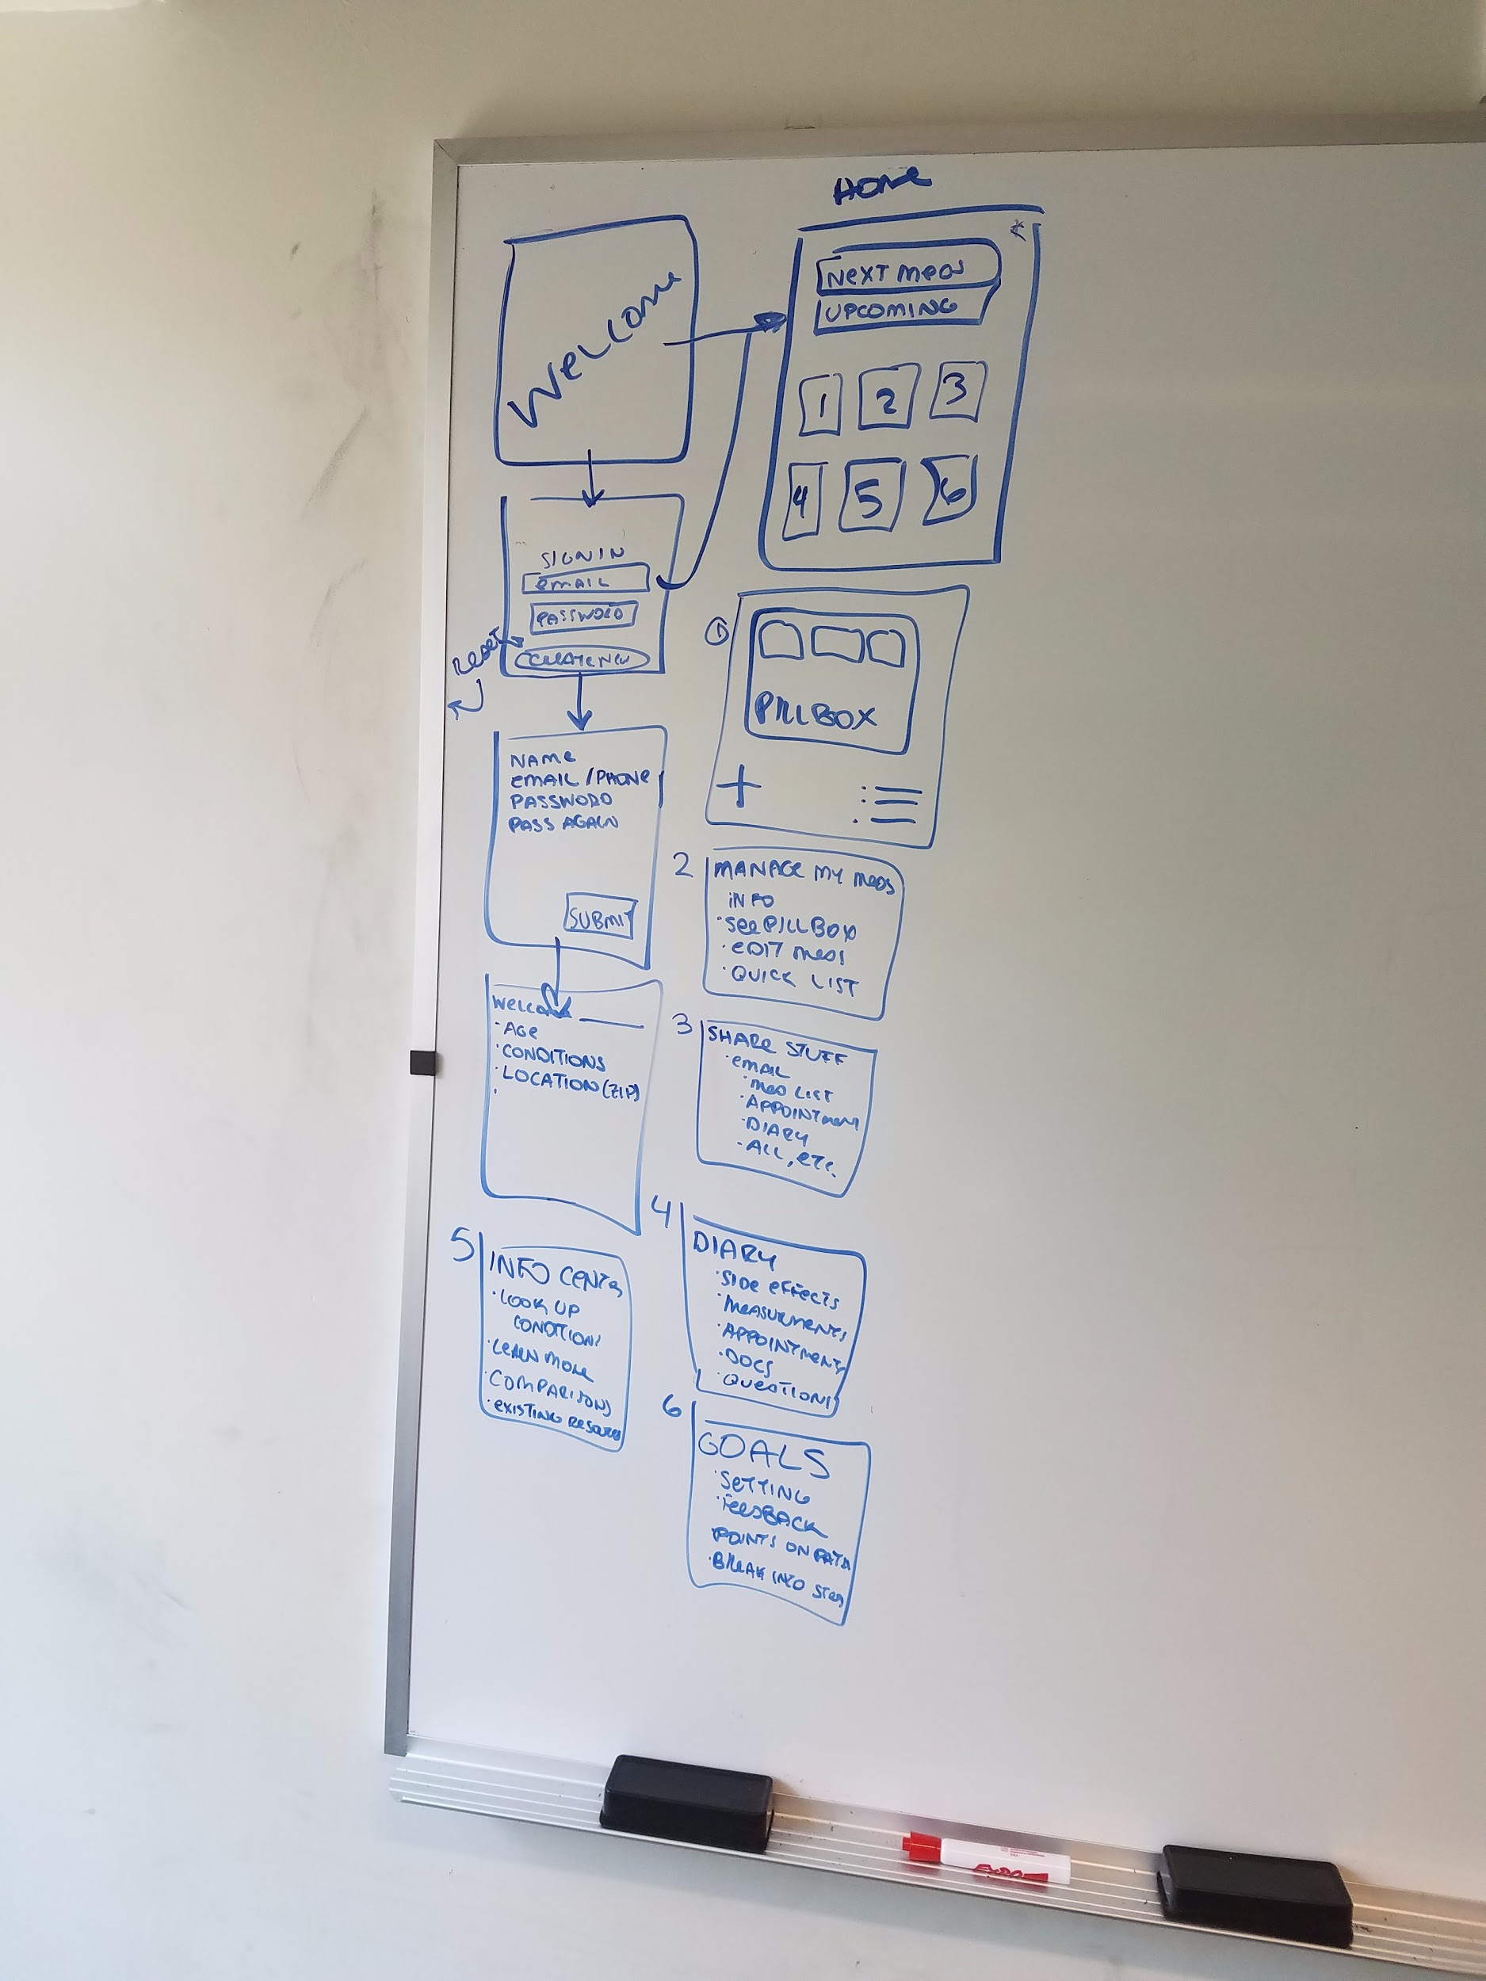
Wireframes
Pillbox
Medications
Share info
Diary
Goals

